Slide 1

Online Shopping System
Project Guide:
Mr. Vaibhav Yavalkar
Student ID | Group Members
21107045 | Mustafa Shaikh
21107004 | Sumit Shahu
21107057 | Pravesh Yadav
21107059 | Hrithik Singh

Slide 2
Contents
Introduction
Objectives
Scope
Features
Project Outcomes
Technology Stack
Block Diagram

Slide 3
Introduction
It is form of electronic commerce .
Consumers directly buy goods from a seller over the internet .
No need of intermediary service is required.

Slide 4
Objectives
To provide 24/7 service.
To have a comfort of own home.
To have the customer privacy.

Slide 5
Scope
It can have a lot of stores within a click away.
It can compare a variety of shopping items easily.
It can have discount coupons available online .

Slide 6
Feature
Shop with your credit card .
You can Avoid spam .
Keep password private .
It can save on Gas.

Slide 7
Outcome of Project
Online shopping :- is the best way to buy any item .
Our system provide all genuine and trusty goods , in Single click .

Slide 8
Technology Stack
Front end will consist of:-
JDK -18.0.2.1
NETBEANS 15
Backend will consist of:-
MS SQL

Slide 9
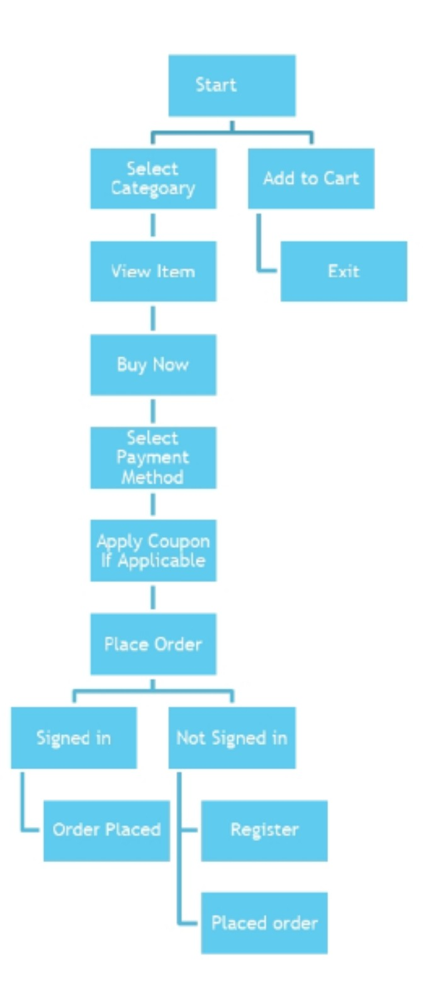
Block Diagram

Slide 10
Thank You

